Slide 1
Kaggle: Otto Group Product Classification Challenge
Jim Thompson
June 2015
Notes:
This deck describes the process and results of my most recent participation in competitive programming for predictive analytics.
For slides where content is not self-explanatory, I’ve include notes to explain the content or provide contextual information.
This presentation attempts to answer the following questions:
What is a Kaggle competition?
How much effort does it take to compete?
What kind of software is used?
How does one go about developing a model and make a submission?
What does a winning model look like?
What did I learn from this competition?

Slide 2
Topics
Kaggle Competition Overview
Model Development and Testing Process
Modeling Process
Feature Analysis
Preparation for Model Development
Final Model
Closing Comments
“The” Winning Model
Lessons For the Next Time

Slide 3
Kaggle Competition Overview

Slide 4
Kaggle Competition Mechanics (Basics)
A company provides Kaggle with data and a business problem.
Kaggle turns the business problem into a predictive analytics challenge, prepares the data into a training data set and test data set and runs the competition.
Competitors, from around the world, obtain the data, develop predictive models using the training data set and submits to Kaggle predictions using the test data set. To avoid gaming the system and/or overwhelming Kaggle’s servers, competitors are limited to the number of submissions allowed in a 24-hour period.
Competitors’ models are evaluated using a performance metric, i.e., RMSE, MAE, AUC, etc., on the models’ predictions.
During competition period (typically 60 to 90 days), competitors are ranked according to the performance metric on a subset of the test data (e.g., 30%).
At the end of the competition period, the competitors are ranked by the performance metric on the remaining portion of the test data set (e.g., 70%). This is the final position for each team and is used to determine prize allocation.
Highest ranked competitors (usually top 3) are awarded prizes, e.g., cash prize.
Sponsoring company obtains rights to the winning models.

Slide 5
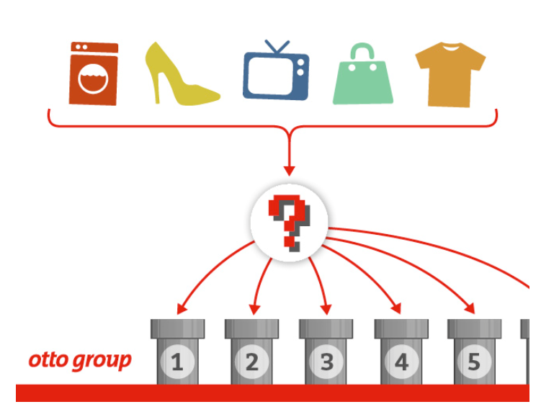
Otto Group Challenge Overview
The Otto Group is one of the world’s biggest e-commerce companies, with subsidiaries in more than 20 countries, including Crate & Barrel (USA), Otto.de (Germany) and 3 Suisses (France). They sell millions of products worldwide every day, with several thousand products being added to the product line.
A consistent analysis of the performance of our products is crucial. However, due to our diverse global infrastructure, many identical products are classified differently. Therefore, the quality of our product analysis depends heavily on the ability to accurately cluster similar products.
The objective is to build a predictive model which is able to distinguish between our main product categories. The winning models will be open sourced.
Largest Kaggle
Competition To-Date
3,514 Teams Participated
The objective of the contest is to predict for each product a set of probabilities of that product being in a class.

Slide 6
Otto Group Challenge Data
Kaggle Training Data Set
61,878 observations
1 identifier attribute
93 explanatory attributes (feat_1, …, feat_93), numeric counts
Response attribute designating the product category (Class_1, …, Class_9)
Used to train model(s)
Kaggle Test
Data Set
144,368 observations
1 identifier attribute
93 explanatory attributes
Used to make predictions for submission
Evaluation metric for predictions is basis for leaderboard score
Notes:
Kaggle provides two data sets for each contest. One data set is used to develop (“train”) a predictive model. Once the predictive model is developed, the model is used to make predictions on the “test” data set. Predictions from the “test” data set are sent to Kaggle for scoring.

Slide 7
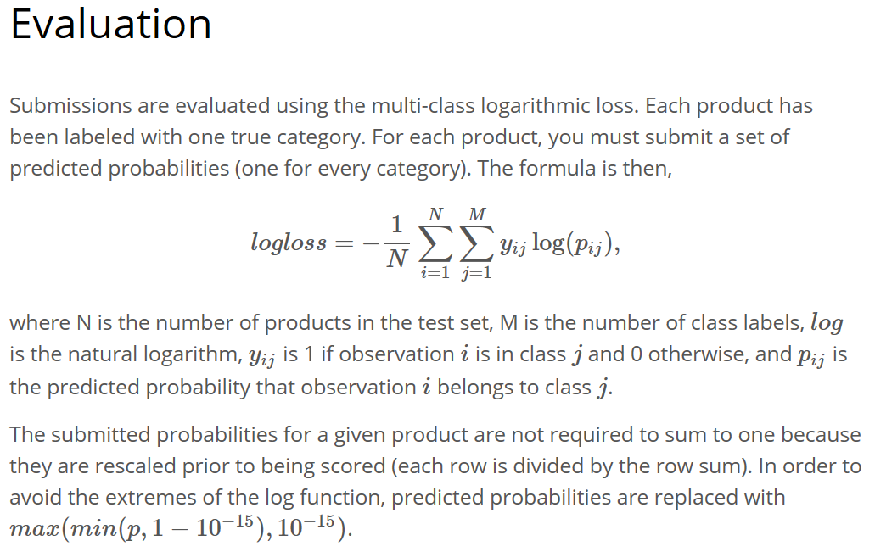
Otto Group Performance Metric
Notes:
For this contest the model performance metric is the multi-class logarithmic loss function. Lower the value of the function indicates a better model.

Slide 8
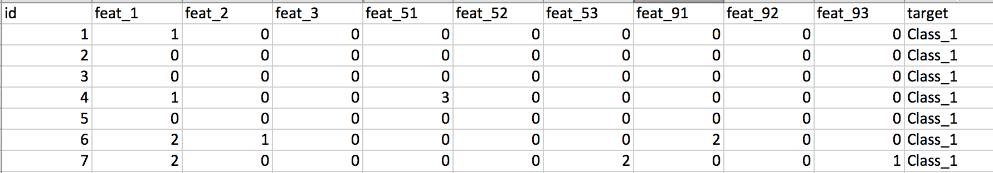
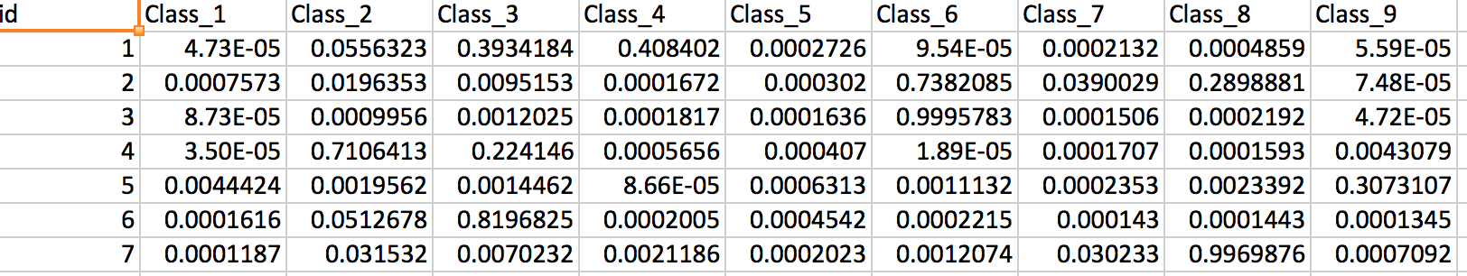
Sample Data and Predictions
Sample Training Data Set
Sample Prediction Data Set
Notes:
This slide shows sample training data set at the top. Note: Only a subset of the feature columns are shown.
The bottom figure shows the expected output from the predictive model. For each product the model must predict the probability that product is in Class_1 through Class_9. This is submitted to Kaggle for scoring.
Looking at the sample prediction:
For id=1, looks like it could be a toss up whether that product is Class_3 or Class_4, given the closeness of the probabilities. However, if one had to classify this product, Class_4 would be selected.
For id=3, the product clearly seems to belong in Class_6.

Slide 9
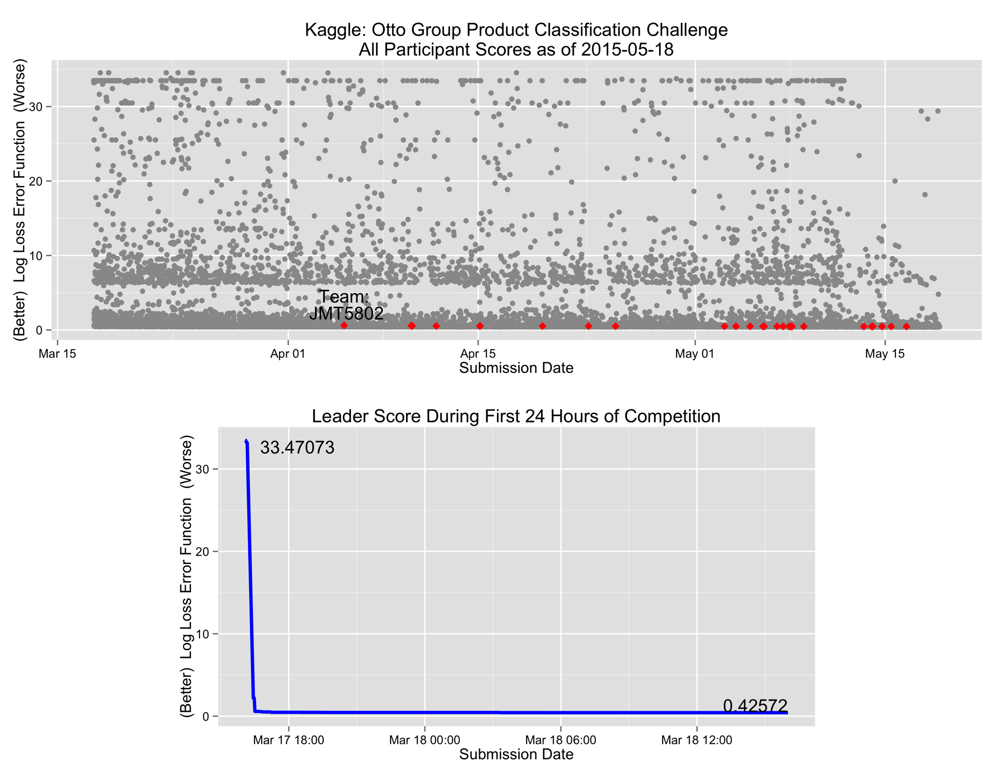
Notes:
Top chart shows the public leader board score for all competitors during the competition period: March 17, 2015 to May 18, 2015. Each grey point represents a team’s submission. The horizontal position indicates the date of submission, vertical position indicates the submission’s score. Lower vertical position indicates a better model. Red points represents submissions by me (Team JMT5802).
For this contest, competitors were allowed only 3 submissions in a 24-hour period, which reset everyday at 23:59 UTC.
An interesting side note:
The bottom chart shows the Leader’s score during the first 24 hours of the competition.
Competition opened on 17Mar/15:56 UTC. The first submission at 17Mar/16:04 UTC , eight minutes after the contest opened, resulted in a score of 33.47073.
At 17Mar/16:26 UTC the Leader’s score dropped to 2.19722, the 5th submission.
Four minutes later at 17Mar/16:30 the Leader’s score was 0.57575, the 8th submission of the contest.
By the 24 hour mark, there were 450 submissions and the Leader’s score dropped to 0.42572. During this period, the team in the Leader position changed ten times.

Slide 10
Model Development and Testing Process

Slide 11
Modeling Process
Feature Extraction
Feature Analysis
Feature Engineering /Selection
Model Training
Model Assessment
Notes:
Feature Extraction – reading and preparing data for modeling
Feature Analysis – analysis and visualization of candidate features to identify candidates for modeling
Feature Engineering/Selection – create data sets for model training
Model Training – train model to make predictions using the selected set of features
Model Assessment – assess how well the model performed against the test.raw data set
The objective is to rapidly iterate through the steps of the above cycle to create incrementally better models.

Slide 12
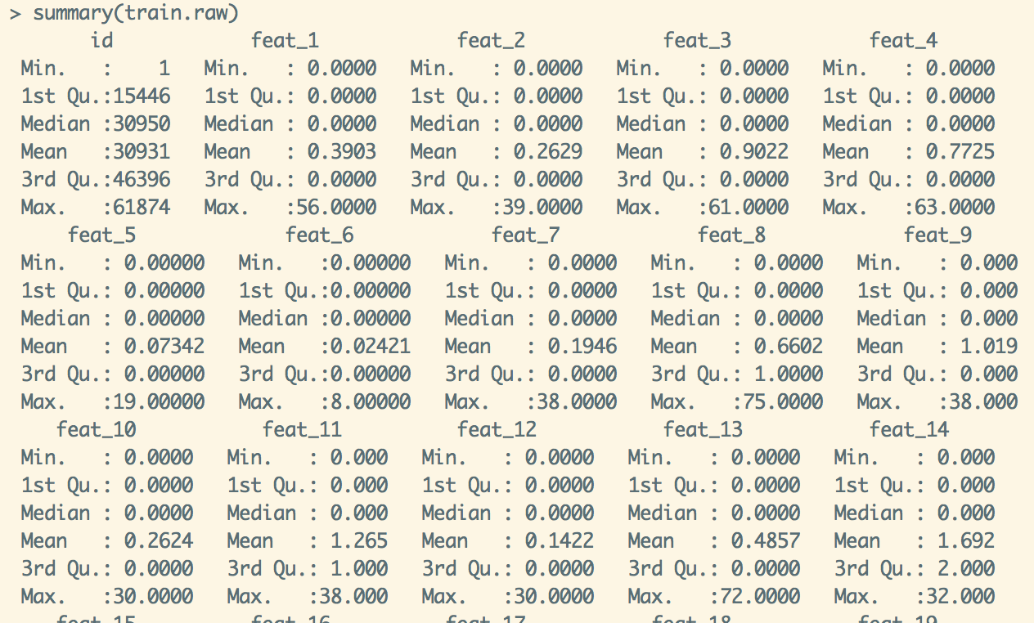
Feature Analysis
Notes:
Starting with Feature Analysis, the next few slides shows an analysis of the features.
Above shows basic statistics for a subset of features.
The statistics shown are typical of all features (feat_1 … feat_93).
One observation: over three quarters of the values are zero for many of the features. The data is highly skewed to the right.

Slide 13
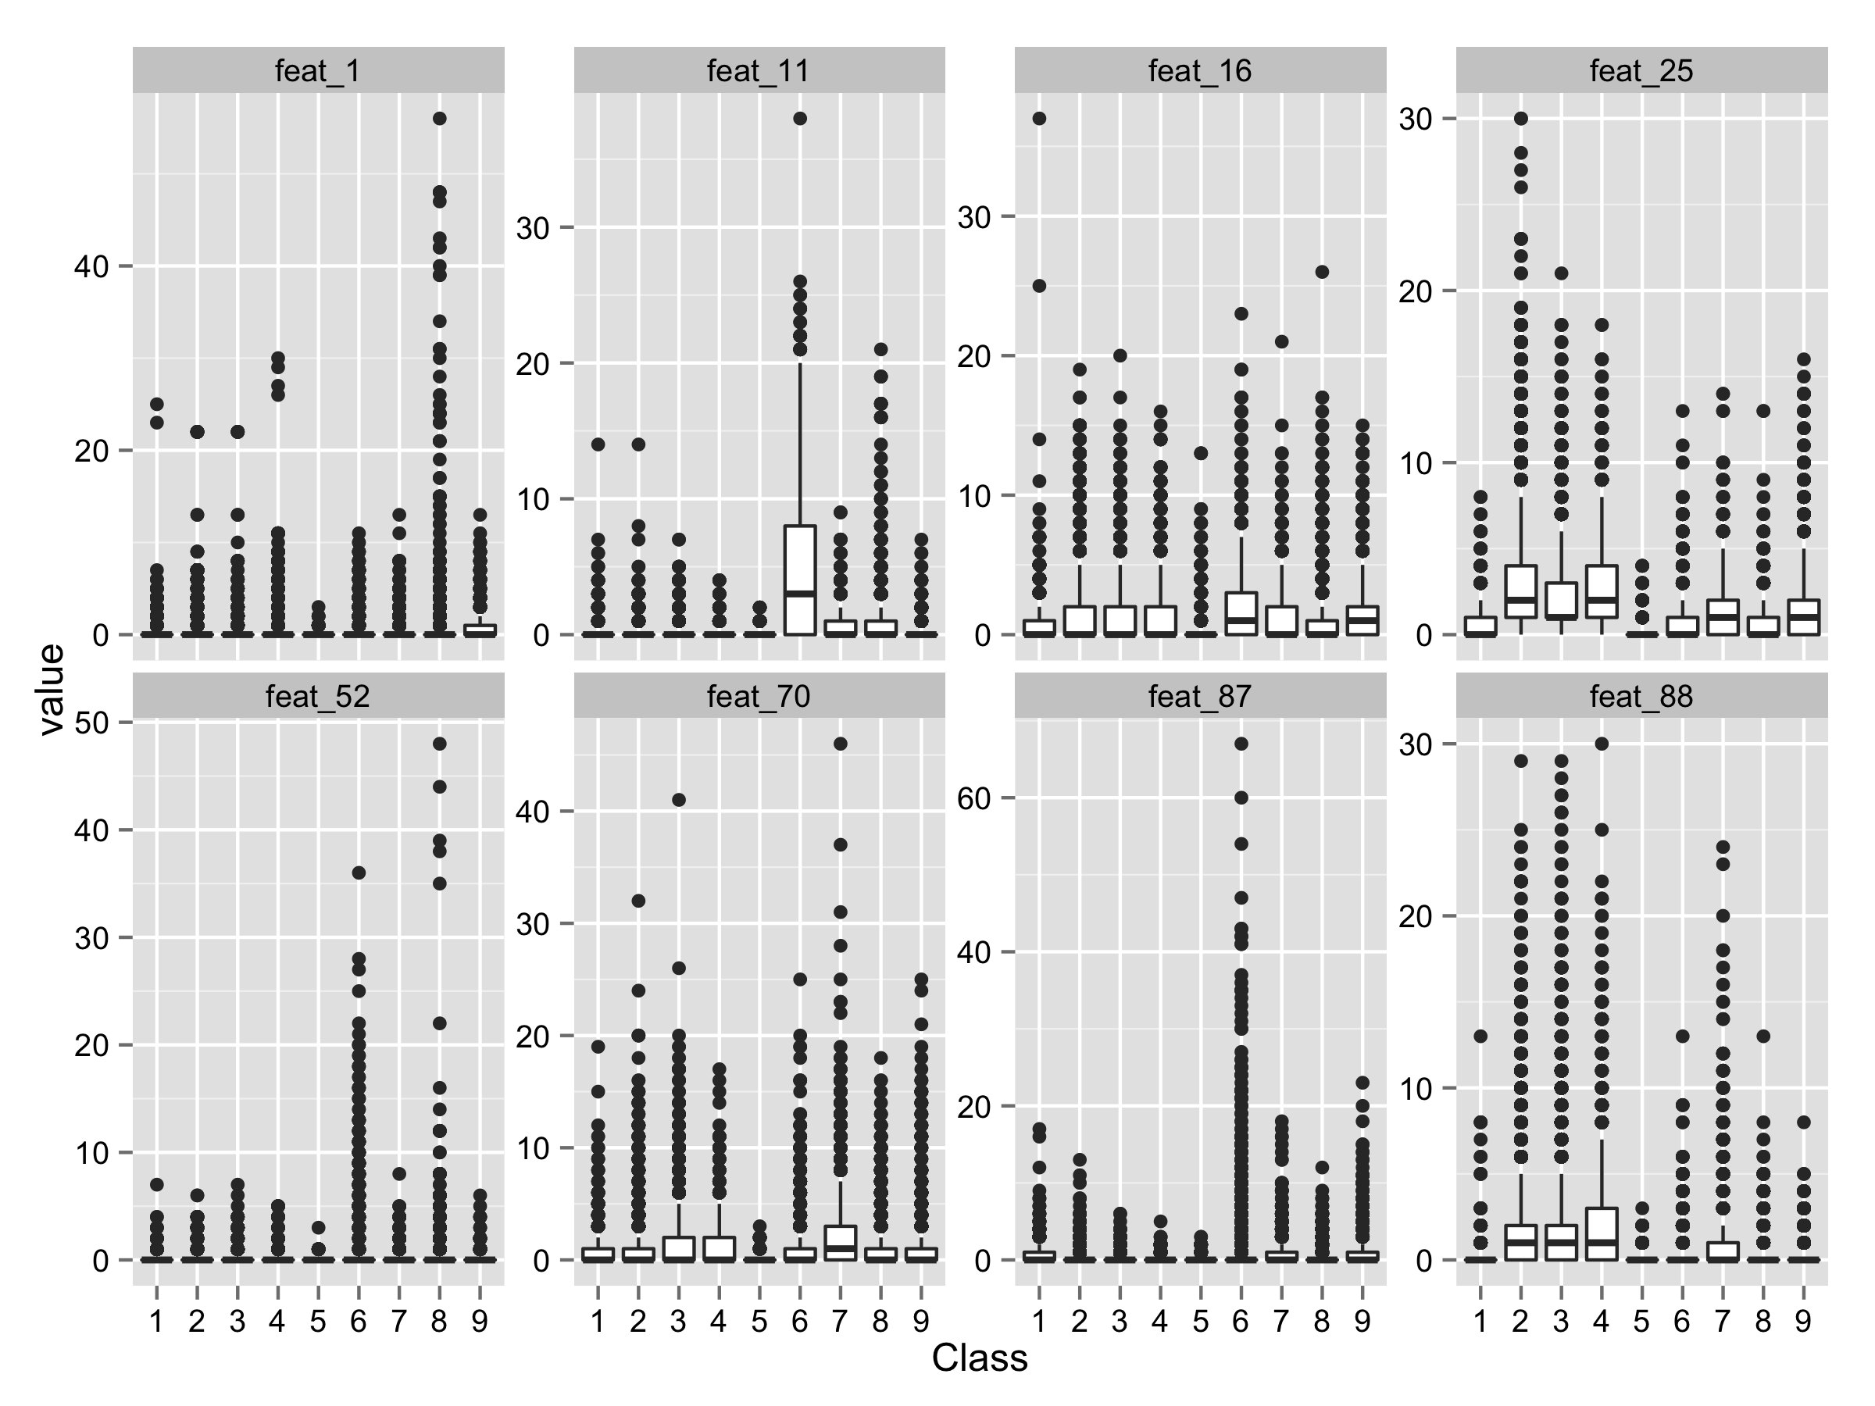
Feature Analysis - Boxplot
Notes:
This and the next chart show the distribution of values of several features by product class. The remaining features have similar appearance.
All the features have large number of outliers.

Slide 14
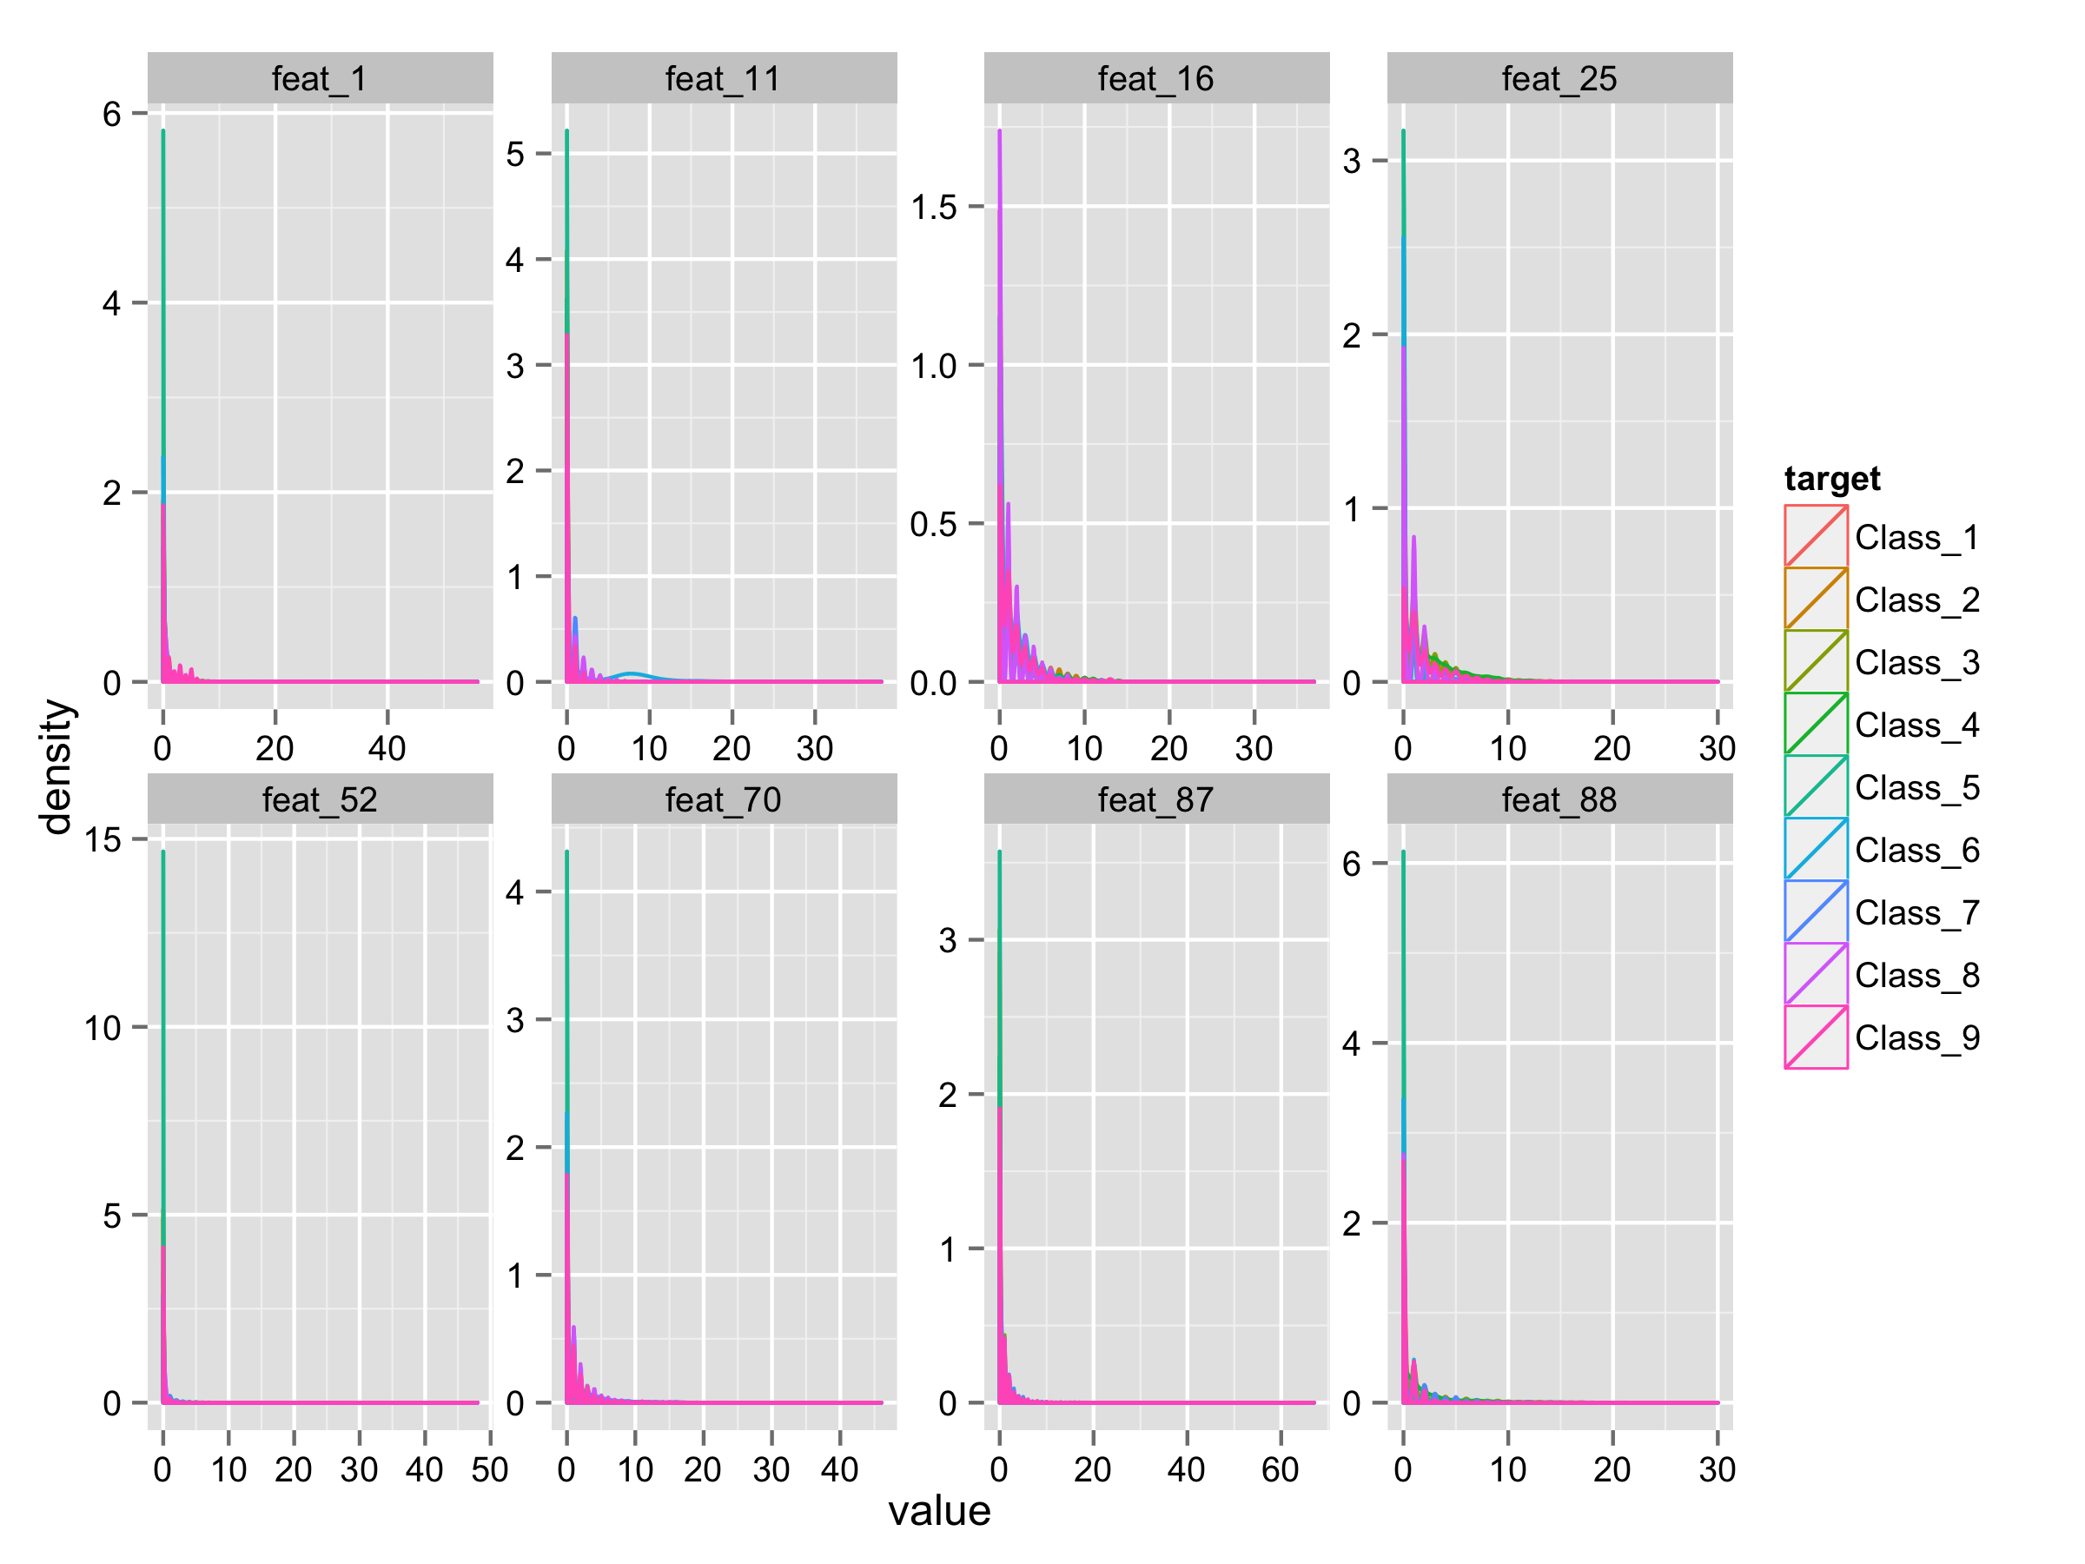
Feature Analysis - Density
Notes:
These are representative of all the features. There does not seem to be clear separation of product classes.
Overall there does not seem to be much ability in the raw features to discriminate between the classes.

Slide 15
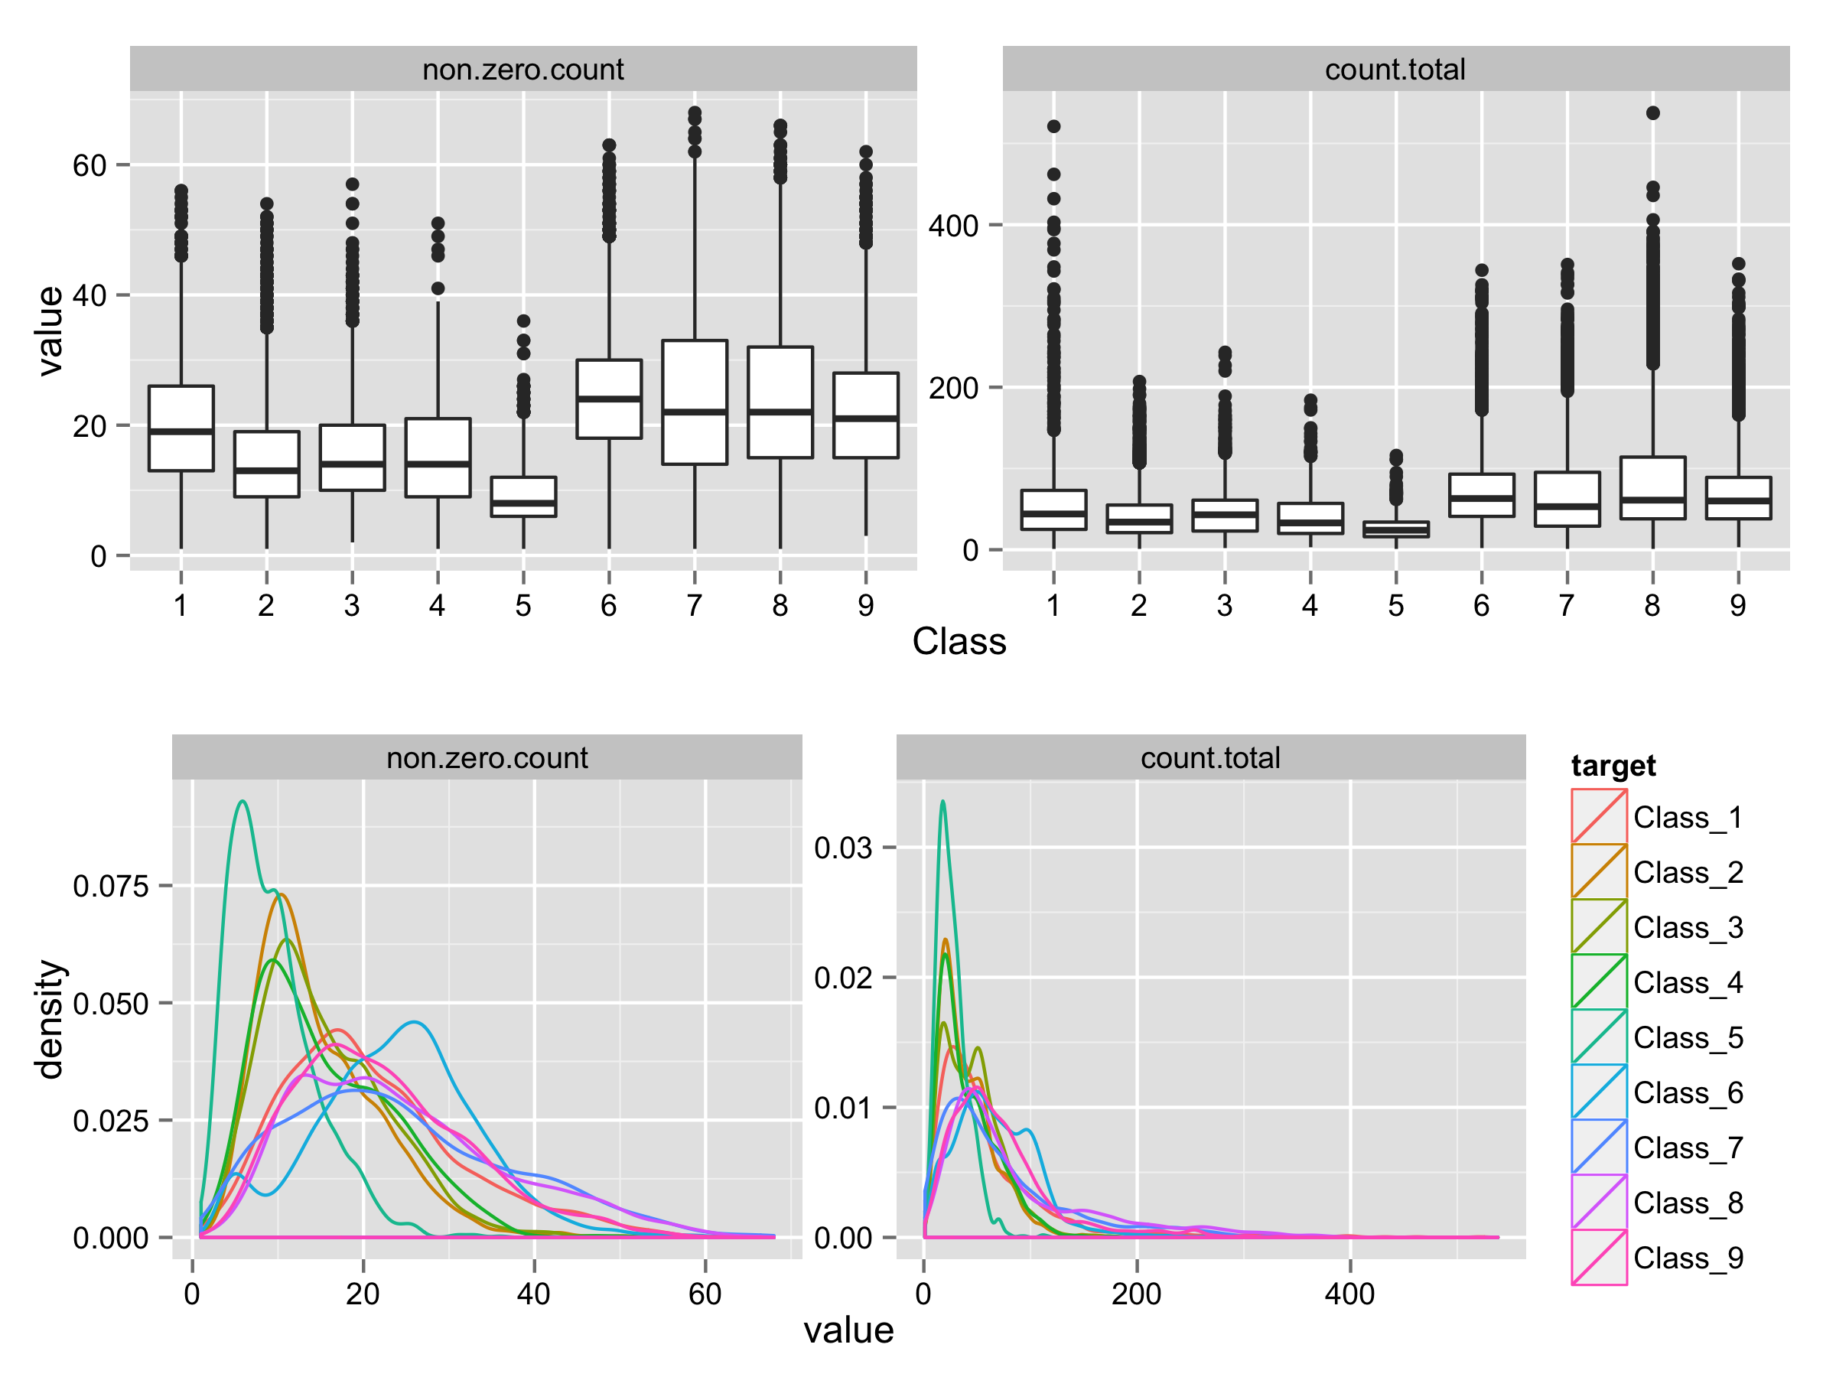
Feature Analysis – Synthetic Features
Notes:
Features that are not part of the original raw data are called synthetic features.
Created two synthetic features.
Number of non-zero features for an observation: non.zero.count.
Sum of features: count.total
As seen by the boxplot and density plots these two features seem to have better ability to discriminant between the classes.

Slide 16
Preparation for Model Development
Objective: Try as many modeling algorithms and features to
identify several reasonably performing models (base learners)
combine the base learners to create a meta model that is used to make submissions to kaggle
Utilized R’s caret package to
facilitate rapid testing of different models
data partitioning
determine optimal model hyper-parameters through cross validation
provide support for resampling
reduce model training time through parallel processing
Webinar on caret package: https://www.youtube.com/watch?v=7Jbb2ItbTC4
Note: There is an audio/video synch problem for the first 11 minutes of the video. After this point, the audio and video are synchronized.
Notes:
The value for using caret is that it takes care of all the tedious and mundane tasks for resampling and searching the hyper-parameter space to determine optimal values. In addition, it provides supporting functions for data partitioning and pre-processing.
In the literature, the writers recommend 5 repeat, 5-fold Cross Validation (CV) or 10 repeart 10-fold CV. For this competition, I decided one repeat, 5-fold Cross Validation (CV) for hyper-parameter tuning. Primary reason was to manage the training time for a model.
Majority of the model training and testing occurred on my personal laptop – MacBook Pro (8 core processor, 16GB RAM, 1TB SSD)
Some model training workload, toward the end of the competition period, moved to Amazon Web Service (AWS) EC2 compute instance 16 core processor, 30GB RAM, 25GB HDD. Using AWS cost me about $100.
Primary reason for this was to achieve higher degree of parallel execution and avoid, potentially, damaging my MacBook Pro laptop. When running parallel compute intensive work on the MacBook Pro, the sensors indicated processor temperatures reaching 96 to 98 degrees Celsius. According to technical specs, the upper temperature limit for processors is 105 degrees Celsius.

Slide 17
Preparation for Model Development
Establish GIT repository for source code change management
Establish coding infrastructure for model building and testing
Coded local version of multinomial log loss (MLL) function
Set up method to capture model performance data
Set up coding conventions and code templates for model training and testing based on R’s caret package
Customized caret to use the MLL for assessing model performance
All source code for this competition can be found in github.com
repository-https://github.com/jimthompson5802/kaggle-OttoGroup
Notes:
The GIT repository was needed facilitate reproducibility of modeling work, i.e., keep track of what version of the software was used to create a model.
The code templates are reusable software assets that facilitate set up to quickly try out different machine learning algorithms. I expect to reuse these templates in future Kaggle competitions.
caret provides out-of-the-box model performance functions. These out-of-the-box functions are RMSE for regression models and Accuracy, Kappa or AUC for classification models. However, caret provides a means to replace their functions with a custom model performance function. By replacing the out-of-the-box functions with the MLL, caret now uses the Kaggle function to direct its hyper-parameter grid search.

Slide 18
Preparation for Model Development
Partition Kaggle Training Data set into three mutually exclusive subsets.
Kaggle Training Data Set
train.raw
60% random sample of Kaggle Training Data
Used to train models
calib.raw
20% random sample of Kaggle Training Data
Used to derive blending weights
test.raw
20% random sample of Kaggle Training Data
Used to estimate model performance
Notes:
Used caret’s createDataPartition function to split the Kaggle Training data set into three parts.
Individual models are built using the train.raw subset.
The approach for combining predictions from the base learners is to take a weighted average of their predictions . The calib.raw data set is used to determine weighting factors.
test.raw is used to estimate of the performance of a model/meta model prior to making a submission to Kaggle.

Slide 19
Preparation for Model Development
Confirmed validity of using MLL score on predictions using the test.raw data set to estimate Kaggle Public Leaderboard MLL score.
Developed models on 10% to 40% of train.raw data
Made predictions on test.raw data and evaluated model performance with local MLL.
Used same models to submit predictions on Kaggle’s test data to get Public Leaderboard score.
Model | Local MLL on test.raw data set | Kaggle Public Leaderboard
gbm | 0.5949307 | 0.60474
rf | 0.5812919 | 0.57400
Notes:
As can be seen the MLL based on the test.raw data is close to what was actually achieved on submitted predictions made one the Kaggle test data set with the same models.
From this I felt comfortable that I could do a lot of testing locally and have a good feel for what I would achieve with a submission to Kaggle.

Slide 20
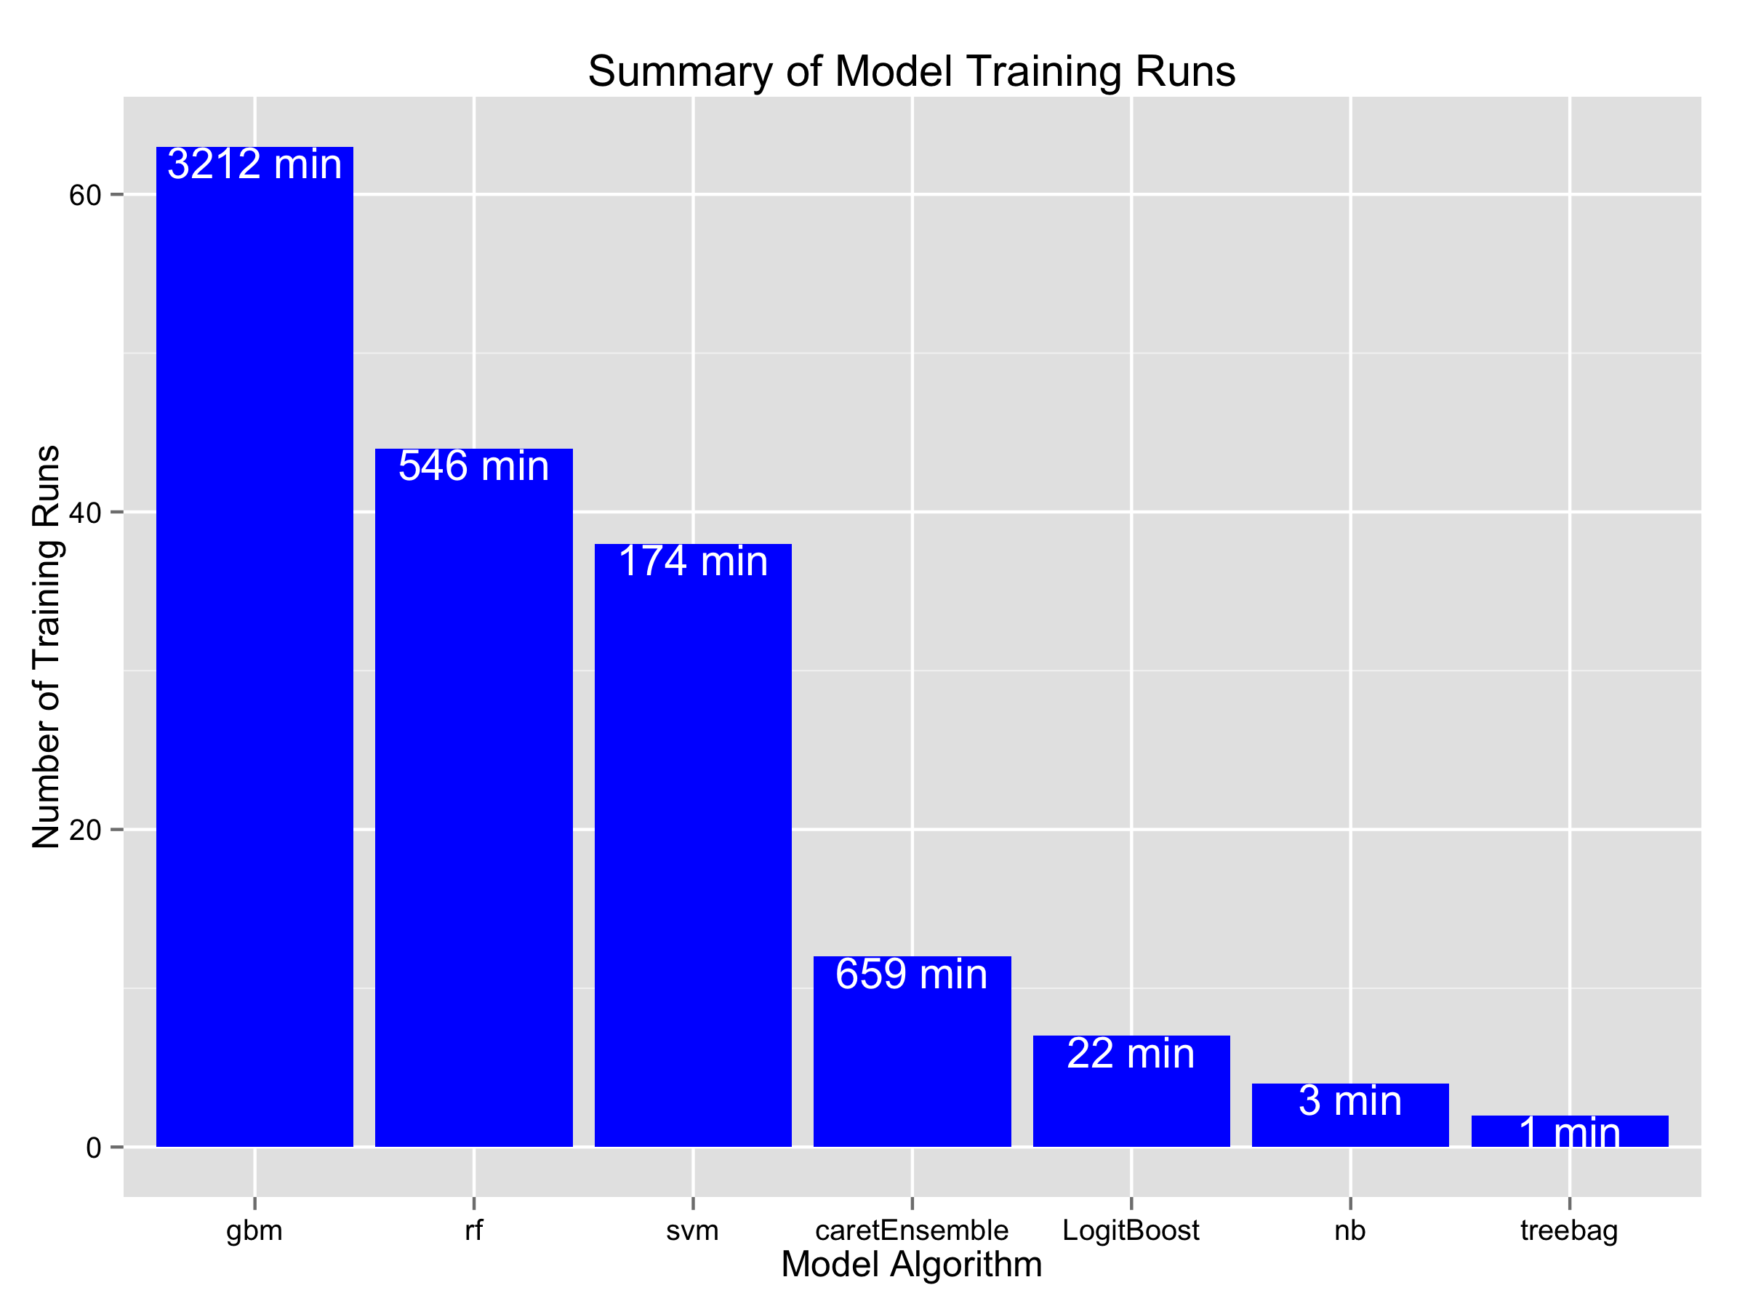
Models Developed and Tested
Notes:
Chart above shows the different type of individual models built and tested over the course of the competition. The height of the bar indicates the number of training runs for a particular model algorithm. The number in the bars show the total elapsed time consumed by the training runs. For example, trained and tested 63 different boosted tree models (gbm). This took over 3,200 minutes or over 53.5 hours. The second most tested model algorithm was random forest (rf), which accounted for 44 models and 9 hours (546 minutes).
In total trained and tested 170 models that took almost 77 hours of execution time. Actually this is a lower bound on the model testing. During the heat of the competition, at the end, did not keep a complete record for creating the meta model.
If we include time for software coding and debugging, feature analysis and model algorithm research, I probably spent 100+ hours on the competition during a six week period.

Slide 21
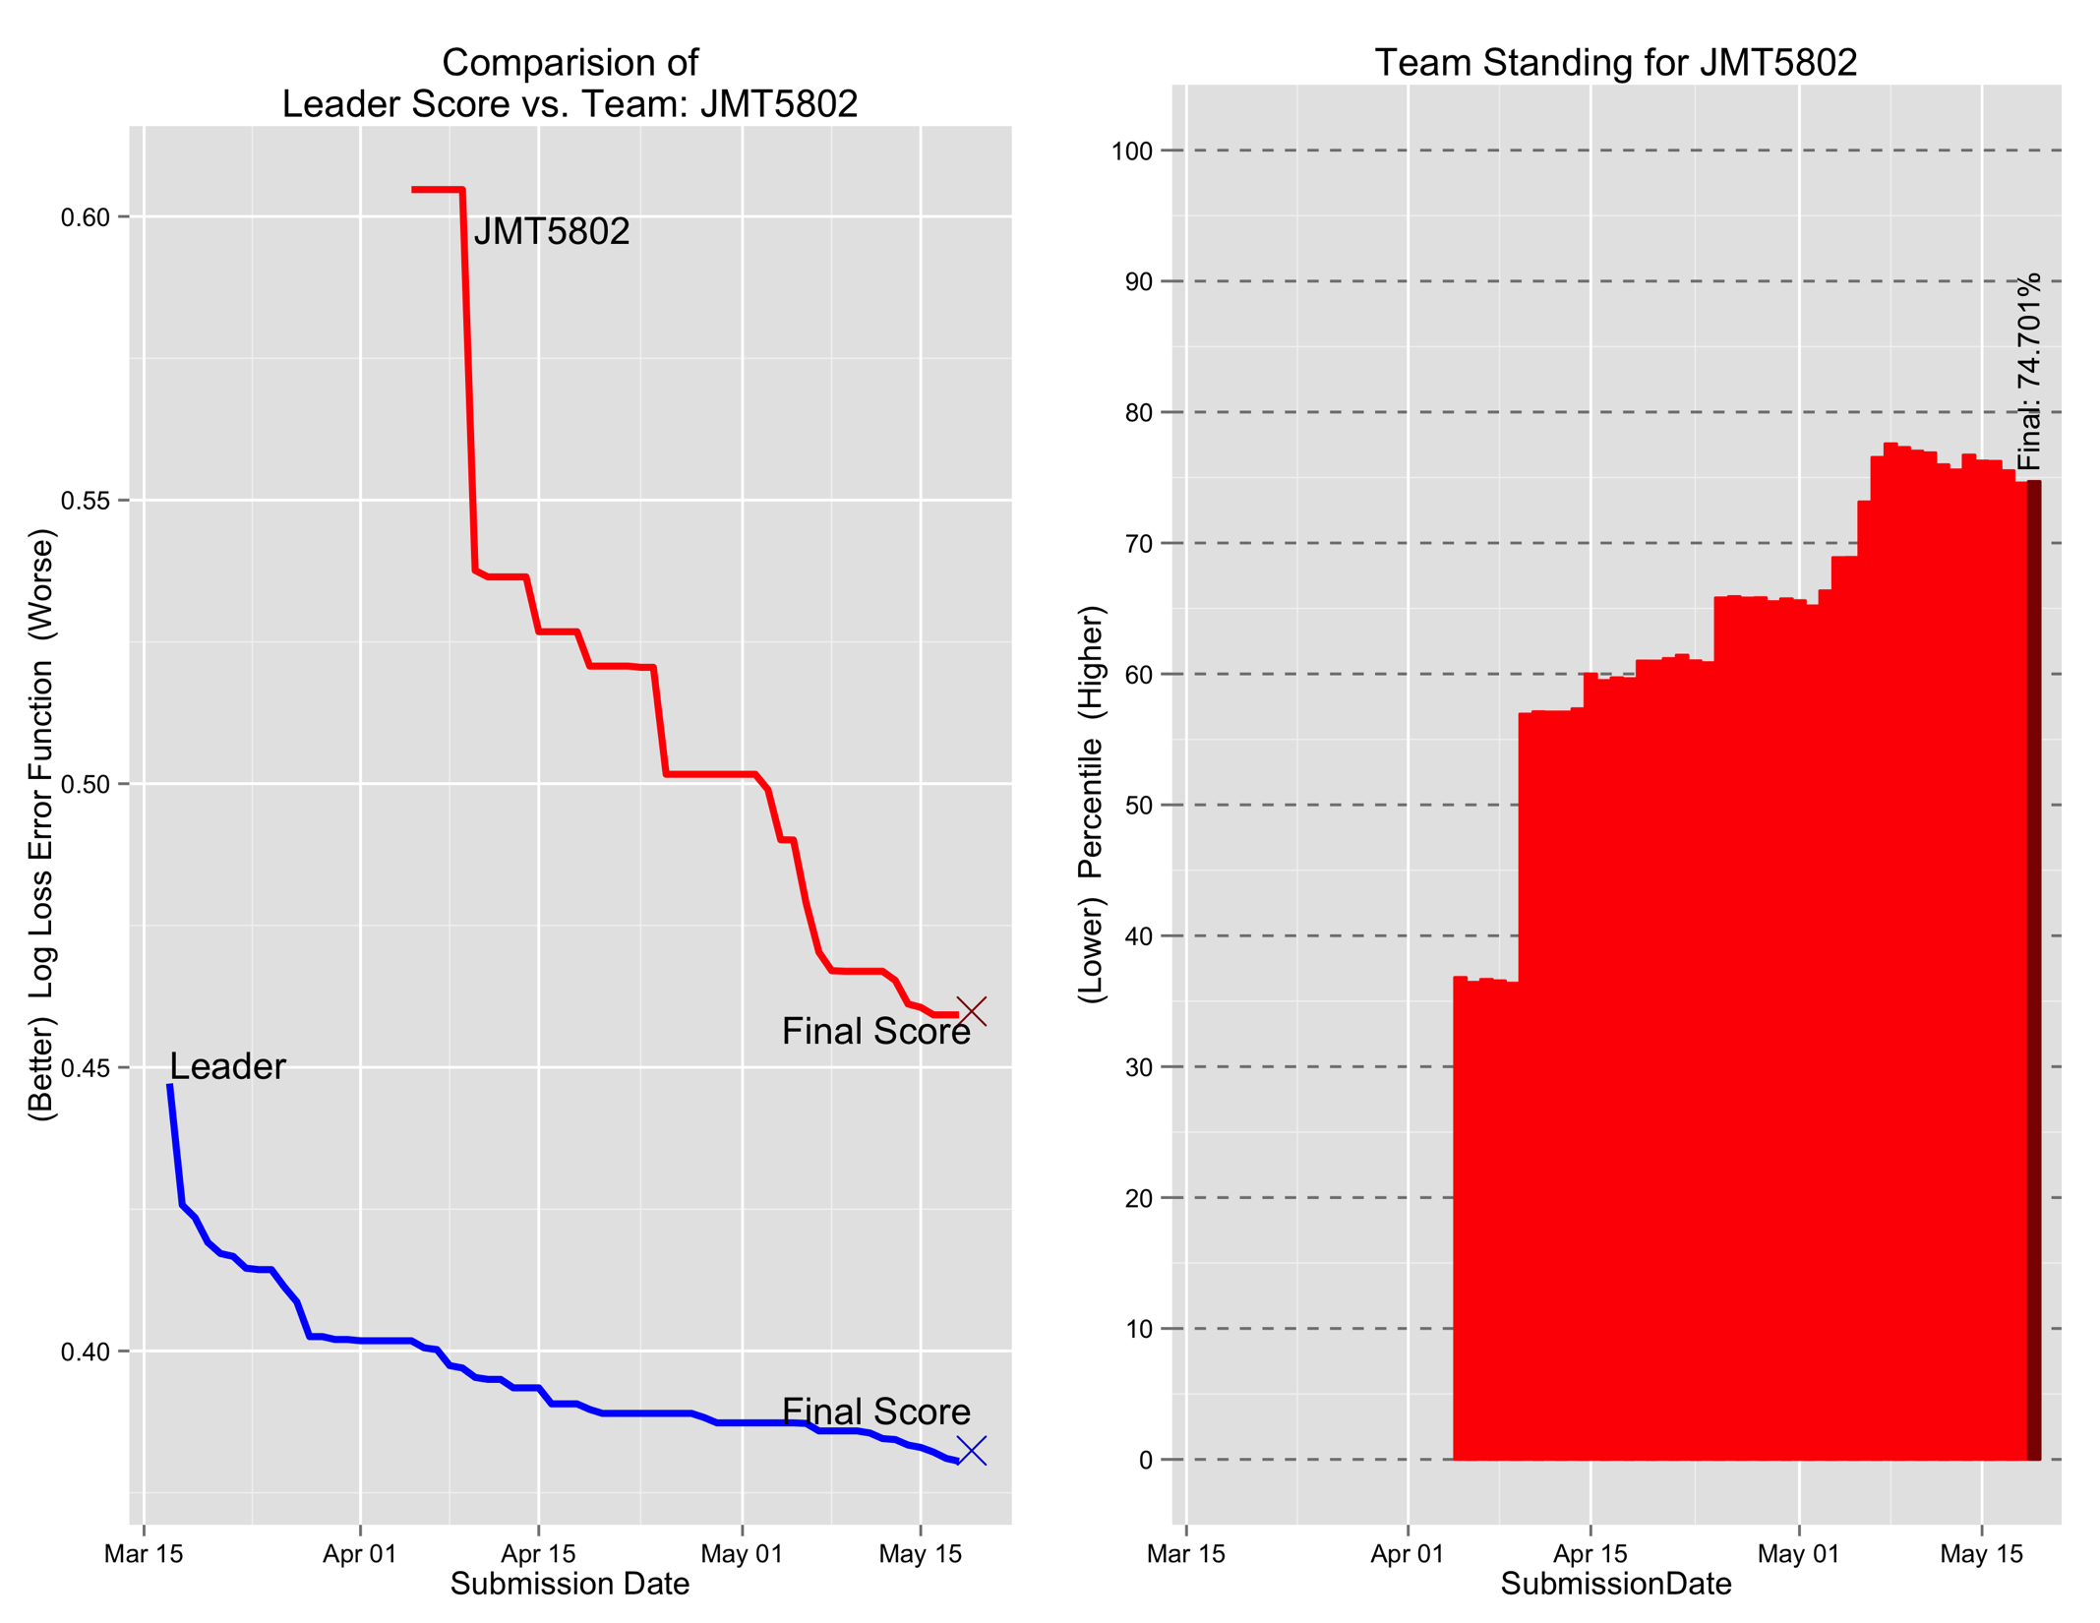
Notes:
During the competition, while developing and testing the 170 model variations, made 51 submissions to kaggle to get kaggle’s view of model performance. As a note of comparison, the 1st place team made 90 submissions to Kaggle, the 2nd place team made 26 submissions and the 3rd place team made 103 submissions.
Chart on the left compares my score with the Leader’s score during the competition, again noting that over the course of the competition, different teams assumed the Leader position. Lines depict the MLL score based on the 30% of the Kaggle test data set (Public Leaderboard Score). The “X” are the final MLL score based on the remaining 70% of the Kaggle test data set at the end of the competition (Private Leaderboard Score).
Chart on the right shows the relative standing for me (Team JMT5802). Height of bar indicates the percentage of teams with a higher MLL score, i.e., worse performing model. The Leader would have a percentage of 100%, At the end of the competition I achieved an MLL of 0.45987, which placed me at 74.7%. If I could have lowered my MLL by 0.00112, I would have moved up 12 positions and achieved a Top 25% badge. “Missed it by that much!”

Slide 22
Final Model

Slide 23
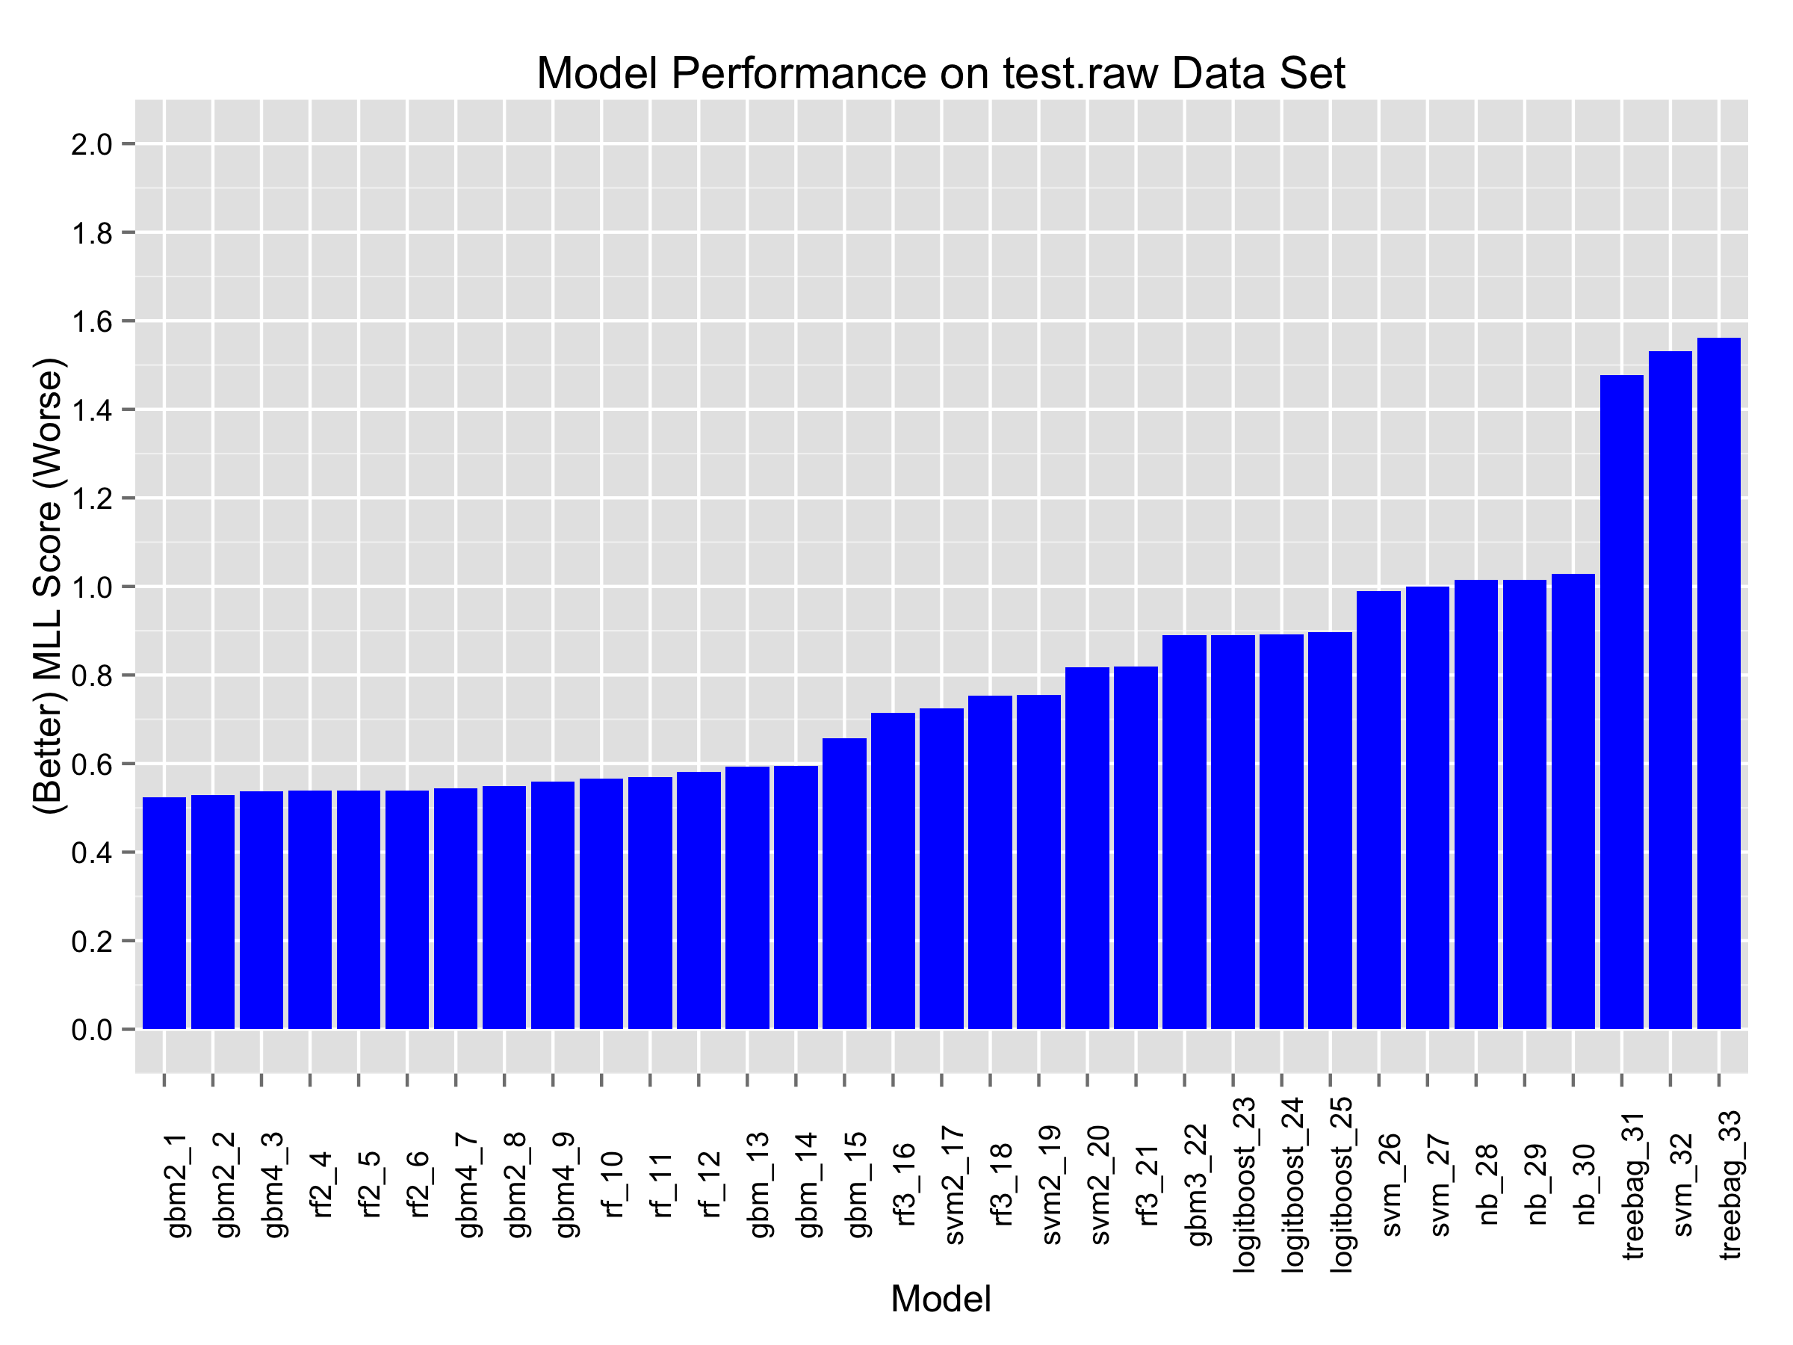
Selecting Base Learners
Notes:
General approach is to combine the predictions of several models to derive the prediction that is sent to Kaggle.
Chart above display the best 3 MLL scores for various individual models tested during development.
Decided to move forward with gbm2, gbm4 and rf2 models as base learners for the final build that are incorporated into the meta model. These three models represent two different algorithms (random forest and boosted trees) and two kinds of feature sets (original features and class specific synthetic features).
In attempt to build the best base learner models, trained the gbm2, gbm4 and rf2 models using the entire collection of train.raw, calib.raw and test.raw data sets. Use of test.raw in model training prevented its use in estimating the kaggle Public Leaderboard score after this point. From this point on, I was flying blind on how well any subsequent submission to Kaggle would perform.

Slide 24
Random Forest Model (rf2)
Random Forest model created with randomForest package.
Features: original 93 features with non.zero.count synthetic feature
Combined train.raw, calib.raw and test.raw into single training data set (61,869 records)
Public Leaderboard MLL score for rf2: 0.52234
Notes:
The first base leaner. This model was able to make direct multi-class predictions.
The Public Leaderboard score is based on 30% of the Kaggle Test Data set.

Slide 25
Generalized Boosted Model(gbm2)
Created with the gbm package
Model set-up as a “one vs all” structure
Features: original 93 features with non.zero.count synthetic feature
Combined train.raw, calib.raw and test.raw into single training data set (61,869 records)
Trained on Amazon Web Services EC2 Instance
9 Parallel tasks
Elapsed time: 48 minutes
CPU time: 249.80 minutes
Public Leaderboard MLL score for gbm2: 0.50125
Notes:
Second base learner. Due to a bug in gbm was not able use the parameter distribution=“multinomial” to create multi-class predictions. See Appendix for additional details.
Due to the bug, decided to try a “one vs all” approach. This method requires fitting 9 sub-models, each doing a 2-class model. These sub-models predict whether a product is
“Class_1” or “Not_Class_1”
“Class_2” or “Not_Class_2”
…
“Class_9 or “Not_Class_9”
It must be noted that using the “one vs all” approach negated the use of the MLL in tuning the sub-models because each sub-model is focused on only one product class. Tuning for these sub-models were based on AUC for the 2-class model.
To make a submission to Kaggle, the test data were run through each of the 9 sub-models and predictions consolidated to create the multi-class submission required by Kaggle.
One side-effect of using all the Kaggle Training data (train.raw, calib.raw and test.raw) for model training was losing the ability to get an objective estimate on model performance before submitting to Kaggle.

Slide 26
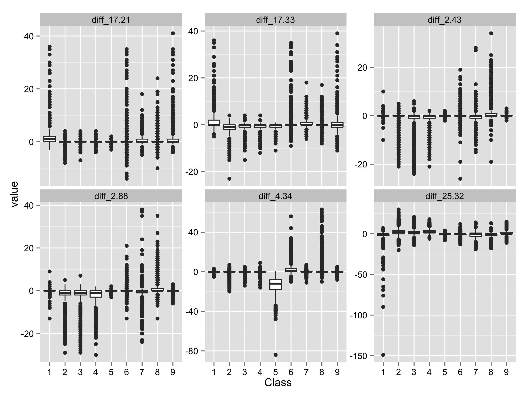
Feature Analysis – Synthetic Features II
Notes:
Toward the end of the competition, decided to try out some other synthetic features. This was specifically geared toward the third model selected to be part of the meta model. The idea behind these features were to create a feature set custom to each product class. In the other two models, the same set of features were used to train those models.
A common technique for generating additional features is taking pairwise differences, sums and ratios. For this competition decided to generate additional features by taking the pairwise differences. Decided against pairwise ratios to avoid having to dealing with large number of missing values due to division by zero.
Names for the pairwise difference synthetic features were named in the following manner. The synthetic feature for feat_1 – feat_33 is labelled as diff_1.33.
Box plot is a sample of pairwise differences. Taking pairwise differences resulted in an additional 4,278 features, for a total of 4,371, including the original 93 feature set. Trying to include this large number of synthetic features adversely affects run-time for training models.
Reduced synthetic features by using the procedure described on the next slide.

Slide 27
Feature Reduction
Selected features for a one vs all model, i.e., custom features for each class
Eliminate highly correlated features using findCorrelation() function and features with near zero variance using nearZeroVar() from caret. This reduced feature set from 4,371 to 2,776.
For the remaining predictors: Eliminate features that do not have a “significant” effect.
If x is a predictor and y the response variable, caret’s anovaScores() function returns the p-value of the F-statistic for lm(x~y) to assess if the mean of the features is different for different classes.
Due to repeated testing, adjust the cut-off value α using Bonferroni correction, α/M, where M is the number of predictors. In this case, M =2,776.
Eliminate predictors whose p-value exceeds the cut-off value 0.005/2776.
Notes:
findCorrelation - This function searches through a correlation matrix and returns a vector of integers corresponding to columns to remove to reduce pair-wise correlations.
nearZeroVar - Diagnoses predictors that have one unique value (i.e. are zero variance predictors) or predictors that are have both of the following characteristics: they have very few unique values relative to the number of samples and the ratio of the frequency of the most common value to the frequency of the second most common value is large.
Bonferroni Correction – “The Bonferroni correction is a multiple-comparison correction used when several dependent or independent statistical tests are being performed simultaneously (since while a given alpha value may be appropriate for each individual comparison, it is not for the set of all comparisons). In order to avoid a lot of spurious positives, the alpha value needs to be lowered to account for the number of comparisons being performed.” (Taken from Wolfram’s Mathworld: http://mathworld.wolfram.com/BonferroniCorrection.html)

Slide 28
Feature Reduction
Candidate features for each class passing the cut
Class | # of Features | Top 5 Features That Passed the Cut-off
1 | 1,620 | feat_17, diff_17.21, diff_17.33, diff_12.17, diff_17.28
2 | 2,139 | feat_11, feat_14, feat_15, feat_25, feat_33
3 | 1,914 | feat_9, feat_43, feat_88, diff_2.43, diff_2.88
4 | 1,465 | diff_25.48, diff_15.67, diff_18.25, diff_15.32, diff_18.88
5 | 1,256 | feat_34, non.zero.count, diff_4.34, diff_8.34, diff_9.34
6 | 2,331 | feat_3, feat_4, feat_11, feat_14, feat_21
7 | 1,725 | feat_39, feat_50, diff_1.45, diff_1.50, diff_2.45
8 | 2,258 | feat_2, feat_7, feat_19, feat_20, feat_24
9 | 2,072 | feat_8, feat_36, feat_41, feat_53, feat_59
Given the number of candidate features, decided to take the top 150 for each class in modeling.
Notes:
The table above shows the number of candidate features for use in the “one vs all” model training. The number of features for each class is still quite high.
Used “analyst judgement” to select only the top 150 features. Features are ordered by the p-value coming from the anovaScores() function.
The table shows that for some classes the synthetic features may have a significant effect.

Slide 29
Generalized Boosted Model (gbm4)
Created with the gbm package
Model set-up as a “one vs all” structure
Features: 150 custom features for each class derived by the feature reduction procedure described
Combined train.raw, calib.raw and test.raw into single training data set (61,878 records)
Trained on Amazon Web Services EC2 Instance
9 Parallel tasks
Elapsed time: 80 minutes
CPU time: 311 minutes
Public Leaderboard MLL score for gbm4: 0.54315
Notes:
This is the third base learner.
The same considerations for model tuning as for the gbm2 model applies to this model as well. In other words, 9 sub-models were fitted and each was tuned based on its individual AUC measure. Predictions for submission were created the same way by running each of the 9 sub-models and consolidating their predictions.
Tried several times to optimize the hyper-parameters for this particular model. One run took about 12 hours elapsed time on AWS with 9 parallel tasks. However, the resulting model did not improve the final score.
On reflection, I probably should have started smaller and built up the feature set. Instead of starting with 150 features, should have started with smaller (10 to 20) feature set and training examples to allow faster turn-around and added features as needed. The number of features may have introduced too much noise into the data.
One side-effect of using all the Kaggle Training data (train.raw, calib.raw and test.raw) for model training was losing the ability to get an objective estimate on model performance before submitting to Kaggle.

Slide 30
Architecture for Meta Model
Kaggle
Submission
Predictors
Models
Original Features + non.zero.
count
rf2
Kaggle Test
Data Set
gbm2
Meta Model
Predictions
Class Specific Synthetic Features
gbm4
Notes:
How the three models described is shown on this slide.
Diagram shows the flow of data and model results to create the predictions for submission to Kaggle.
The Kaggle Test Data Set is processed to create the relevant predictor data sets. These are then fed into the rf2, gbm2 and gbm4 models. Predictions from these models are fed into the Meta model, where the predictions are combined using the weighting factors. Output from the Meta model is the set of predictions submitted to Kaggle.

Slide 31
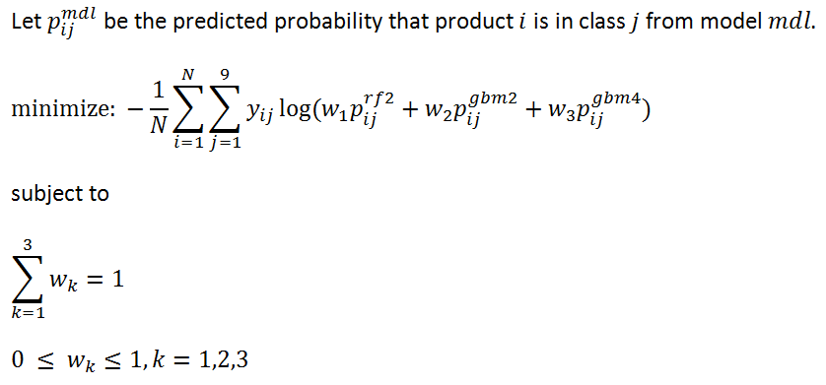
Meta Model
Determine weights w₁, w₂ and w₃ to the following constrained non-linear optimization problem.
Notes:
The predicted probabilities used for this optimization came from the three models using the calib.raw data set.

Slide 32
Meta Model
Used constrOptim.nl function from the R package alabama to solve the optimization problem.
Optimal weights found to be
w₁ = 2.383220e-01, w₂ = 7.616780e-01, w₃ = 2.786556e-09
Public Leaderboard MLL score for Meta Model: 0.45925.
The Meta Model score is about 8% better than the best base learner model (gbm2) MLL Score of 0.50125.
Model | MLL Score
rf2 | 0.52234
gbm2 | 0.50125
gbm4 | 0.54315
Notes:
Tried several different approaches to optimization before settling on constrOptim.nl.
The optimization run took about 90 minutes. Primary reason due to dependence on numerical computations (difference method) for calculating the gradient, Hessian and Jacobian. Speed up possible if analytic forms of the gradient, Hessian and Jacobian were coded into R functions.

Slide 33
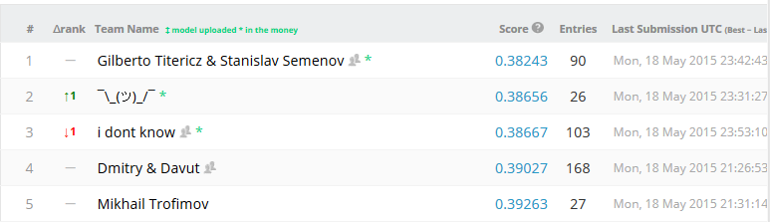
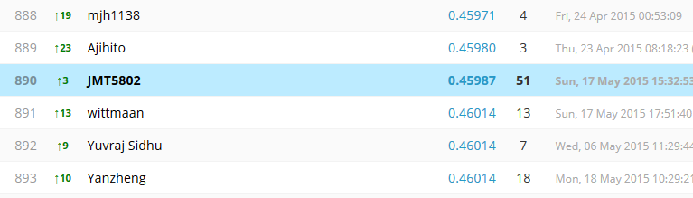
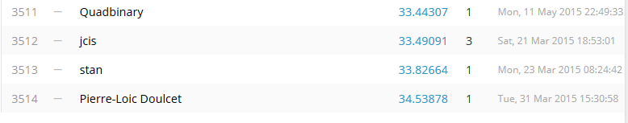
Final Results
Notes:
The slide shows portions of the Private Leaderboard – MLL score based on the remaining 70% of the Kaggle Test Data Set.
The final score of 0.45987 increased slightly over the Public Leaderboard.
I ended up at 890 out of 3,514 teams.
According to timestamps, 2 of the top 3 finishers made their final submission within the last 20 minutes of competition. They were fighting it out to the end.
Re: the 1st place team. According to their profiles, one lives in Brazil and the other in Russian Federation.
One other interesting note: The person at 892nd position is a former Freddie Mac’er.

Slide 34
Closing Comments

Slide 35
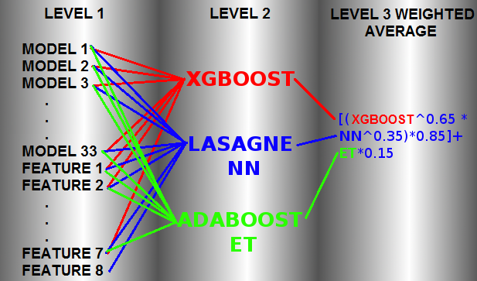
“The” Winning Model
1st Place Team: Gilberto Titericz & Stanislav Semenov
3-layer learning architecture shown below
Level 1: 33 models whose predictions were meta features for the 2nd level plus 8 engineered features.
Level 2: 3 models trained using 33 meta features + 7 features from 1st level: XGBOOST, Neural Network(NN) and ADABOOST with ExtraTrees.
Level 3: weighted mean of 2nd level predictions.
Additional details can be found in the Appendix
Notes:
Shortly after the competition ended, the 1st Place Team posted in the competition's forum a short write-up of their approach:
https://www.kaggle.com/c/otto-group-product-classification-challenge/forums/t/14335/1st-place-winner-solution-gilberto-titericz-stanislav-semenov
Using the same method that the winning team used to describe their approach, my approach involved
A 2-layer architecture
3 models
Different set of “meta features” (aka synthetic features)

Slide 36
Lessons For the Next Time
Improve feature analysis and model diagnostics
Avoid tunnel vision in trying to improve a base learner performance, need to “Let It Go.”
Determine number of observations required for test.raw to give a “close enough” estimate of Kaggle score
Establish meta model structure earlier in the process
Add neural network model to my toolkit
Add Python machine learning packages to my toolkit
Research algorithms (T-SNE, Sofia) cited by the 1st place team
Notes:
Right now feature analysis and diagnosing issues with model fit seem a bit ad hoc. Right now it seems more like an art than a science.
Size of test.raw data set. For this competition, about 12,000 records were allocated to test.raw. It is possible that test.raw could have been smaller and still provide a “good engough” estimate of the Kaggle score. This would have allowed for a larger train.raw data set.
Questions in Kaggle forum competitions from couple of years ago seemed to involve mostly R code. Now discussions in the forum show an increased discussion of Python.

Slide 37
Appendix

Slide 38
R Packages Used in the Competition
Purpose | R Packages
Data Manipulation | plyr, ddplyr, tidyr
Visualization | ggplot2
Model Training and Testing | caret, gbm, randomForest, kernlab, caretEnsemble, adabag, pROC, klaR, caTools, C50, ipred
Constrained non-linear optimization | alabama
Parallel Computation | doMC, doSnow, parallel, foreach

Slide 39
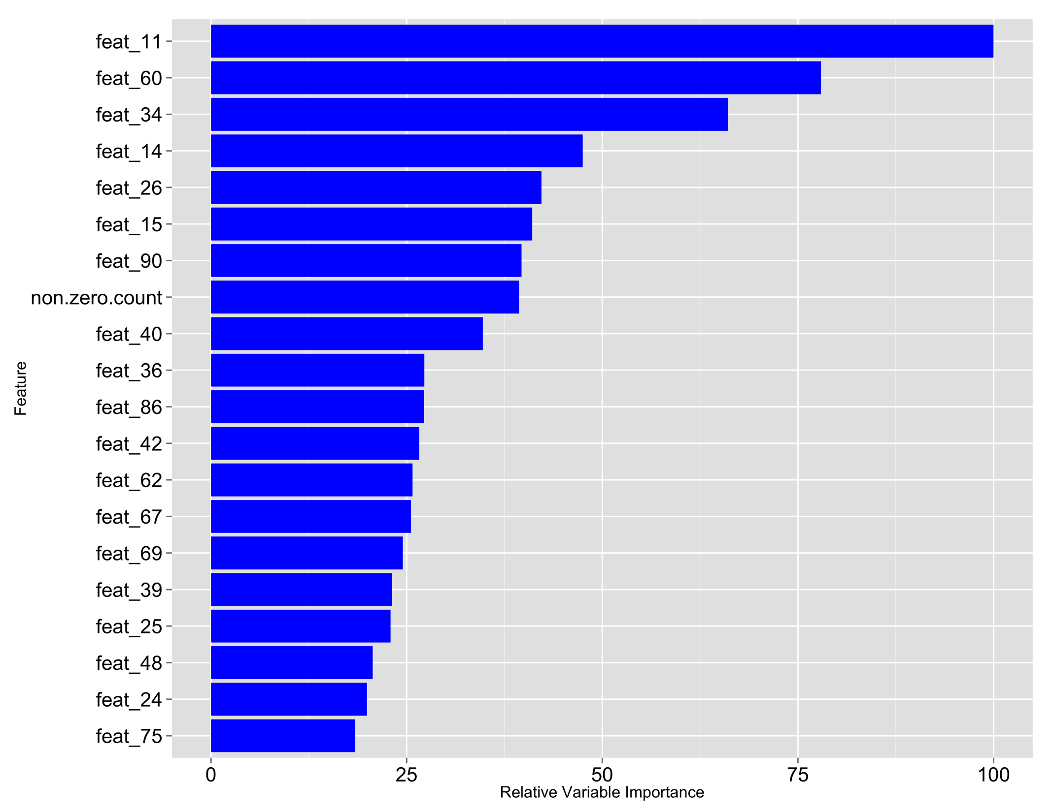
Top 20 Variable Importance for Model rf2
Notes:
The function varImp in the randomForest package computes the importance of variables in building the underlying decision trees. The above chart shows the Top 20 important variables. The most important variable has a value of 100.

Slide 40
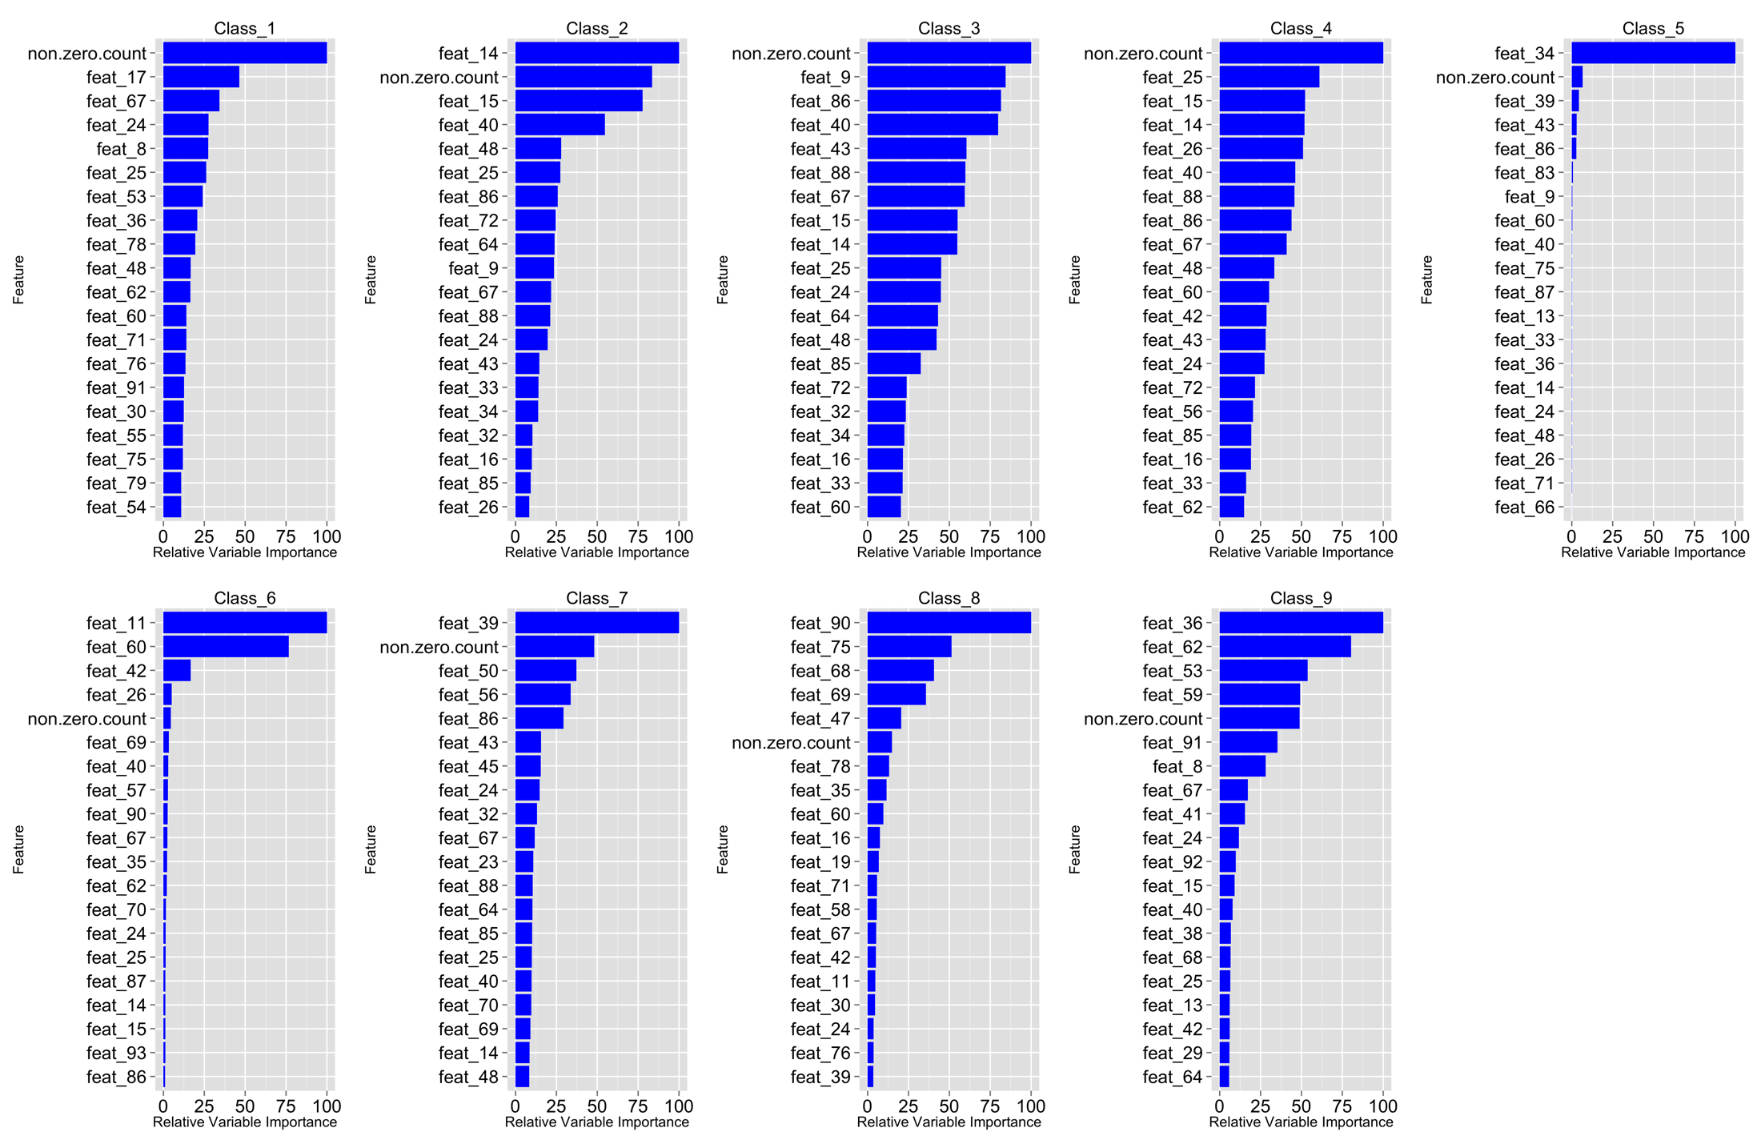
Top 20 Variable Importance for Model gbm2
Notes:
The function varImp in the gbm package computes the importance of variables in building the underlying decision trees. The above chart shows the Top 20 important variables. The most important variable has a value of 100.
Since gbm2 model is a one vs all structure. There are nine plots, one for each class. In the case of Class_1, the synthetic feature non.zero.count is the most important feature in determining whether a product is “Class_1” or “Not_Class_1”.
We note that non.zero.count appears in all Top 20 sub-models. This is consistent with the usefulness implied with density plot for this feature.

Slide 41
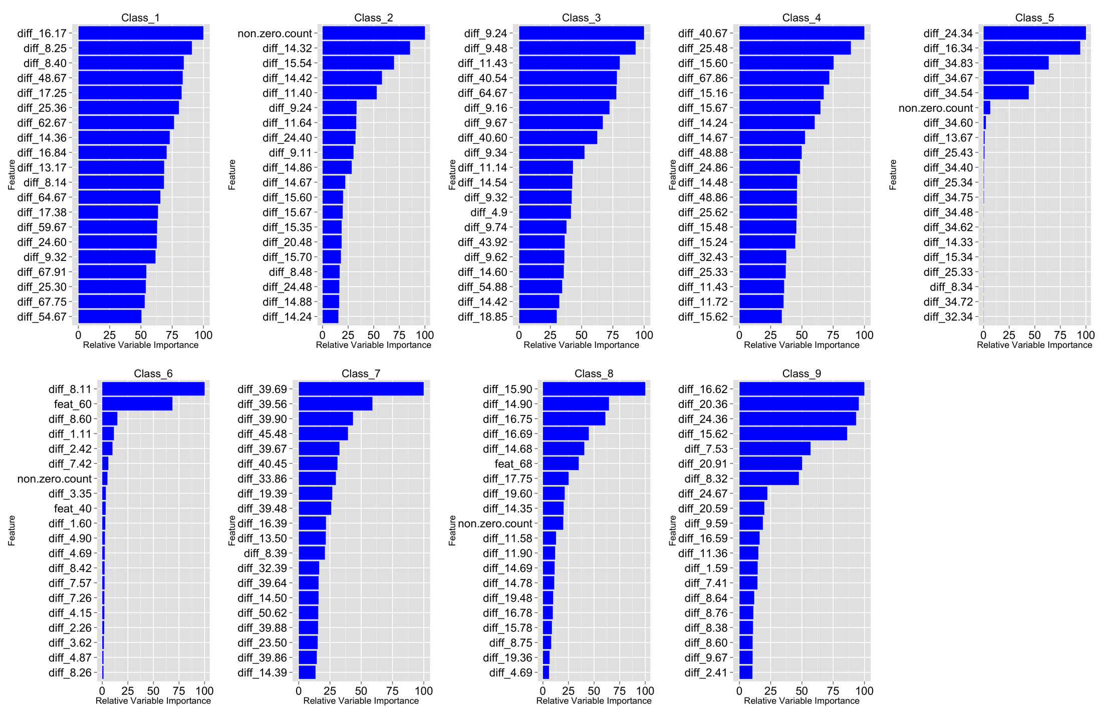
Top 20 Variable Importance for Model gbm4
Notes:
The function varImp in the gbm package computes the importance of variables in building the underlying decision trees. The above chart shows the Top 20 important variables. The most important variable has a value of 100.

Slide 42
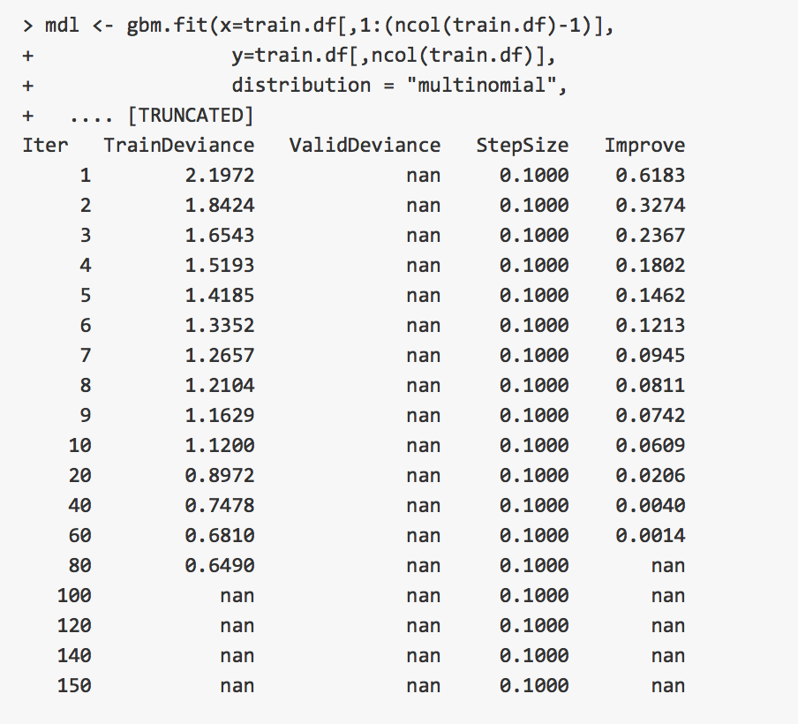
Multi-class gbm Bug
Encountered a bug, NaN error, in using gbm with parameter distribution=“multinomial”.
Bug report: https://github.com/gbm-developers/gbm/issues/29
Notes:
First model developed was a multi-class gbm models. Models trained correctly for small training set size, < 40% of training data. Problem encountered when training data set exceed 40% size. This issue led to the approach of using a “one vs all” model using gbm with distribution=“bernoulli”.
At this time, the bug has not been fixed.

Slide 43
“The” Winning Model
Content for this slide and the next three were taken directly from the winning team’s blog posting:
https://www.kaggle.com/c/otto-group-product-classification-challenge/forums/t/14335/1st-place-winner-solution-gilberto-titericz-stanislav-semenov
Model 1: RandomForest(R). Dataset: X
Model 2: Logistic Regression(scikit). Dataset: Log(X+1)
Model 3: Extra Trees Classifier(scikit). Dataset: Log(X+1) (but could be raw)
Model 4: KNeighborsClassifier(scikit). Dataset: Scale( Log(X+1) )
Model 5: libfm. Dataset: Sparse(X). Each feature value is a unique level.
Model 6: H2O NN. Bag of 10 runs. Dataset: sqrt( X + 3/8)
Model 7: Multinomial Naive Bayes(scikit). Dataset: Log(X+1)
Model 8: Lasagne NN(CPU). Bag of 2 NN runs. First with Dataset Scale( Log(X+1) ) and second with Dataset Scale( X )
Model 9: Lasagne NN(CPU). Bag of 6 runs. Dataset: Scale( Log(X+1) )
Model 10: T-sne. Dimension reduction to 3 dimensions. Also stacked 2 kmeans features using the T-sne 3 dimensions. Dataset: Log(X+1)

Slide 44
“The” Winning Model
Model 11: Sofia(R). Dataset: one against all with learner_type="logreg-pegasos" and loop_type="balanced-stochastic". Dataset: Scale(X)
Model 12: Sofia(R). Trainned one against all with learner_type="logreg-pegasos" and loop_type="balanced-stochastic". Dataset: Scale(X, T-sne Dimension, some 3 level interactions between 13 most important features based in randomForest importance )
Model 13: Sofia(R). Trainned one against all with learner_type="logreg-pegasos" and loop_type="combined-roc". Dataset: Log(1+X, T-sne Dimension, some 3 level interactions between 13 most important features based in randomForest importance )
Model 14: Xgboost(R). Trainned one against all. Dataset: (X, feature sum(zeros) by row ). Replaced zeros with NA.
Model 15: Xgboost(R). Trainned Multiclass Soft-Prob. Dataset: (X, 7 Kmeans features with different number of clusters, rowSums(X==0), rowSums(Scale(X)>0.5), rowSums(Scale(X)< -0.5) )
Model 16: Xgboost(R). Trainned Multiclass Soft-Prob. Dataset: (X, T-sne features, Some Kmeans clusters of X)

Slide 45
“The” Winning Model
Model 17: Xgboost(R): Trainned Multiclass Soft-Prob. Dataset: (X, T-sne features, Some Kmeans clusters of log(1+X) )
Model 18: Xgboost(R): Trainned Multiclass Soft-Prob. Dataset: (X, T-sne features, Some Kmeans clusters of Scale(X) )
Model 19: Lasagne NN(GPU). 2-Layer. Bag of 120 NN runs with different number of epochs.
Model 20: Lasagne NN(GPU). 3-Layer. Bag of 120 NN runs with different number of epochs.
Model 21: XGboost. Trained on raw features. Extremely bagged (30 times averaged).
Model 22: KNN on features X + int(X == 0)
Model 23: KNN on features X + int(X == 0) + log(X + 1)
Model 24: KNN on raw with 2 neighbours
Model 25: KNN on raw with 4 neighbours
Model 26: KNN on raw with 8 neighbours

Slide 46
“The” Winning Model
Model 27: KNN on raw with 16 neighbours
Model 28: KNN on raw with 32 neighbours
Model 29: KNN on raw with 64 neighbours
Model 30: KNN on raw with 128 neighbours
Model 31: KNN on raw with 256 neighbours
Model 32: KNN on raw with 512 neighbours
Model 33: KNN on raw with 1024 neighbours
Feature 1: Distances to nearest neighbours of each classes
Feature 2: Sum of distances of 2 nearest neighbours of each classes
Feature 3: Sum of distances of 4 nearest neighbours of each classes
Feature 4: Distances to nearest neighbours of each classes in TFIDF space
Feature 5: Distances to nearest neighbours of each classed in T-SNE space (3 dimensions)
Feature 6: Clustering features of original dataset
Feature 7: Number of non-zeros elements in each row
Feature 8: X (That feature was used only in NN 2nd level training)

